Slide 1
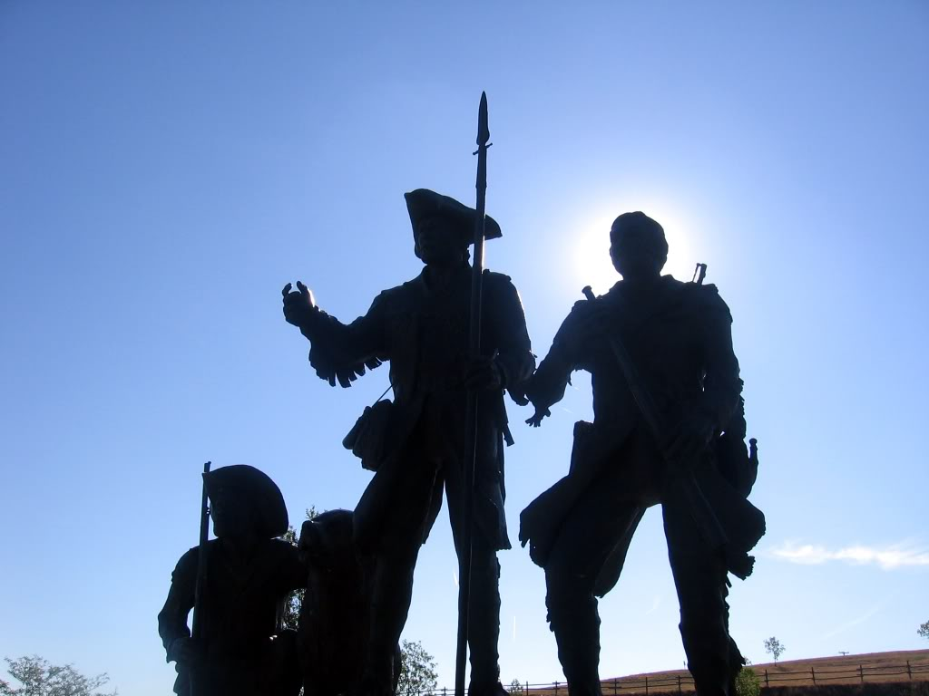
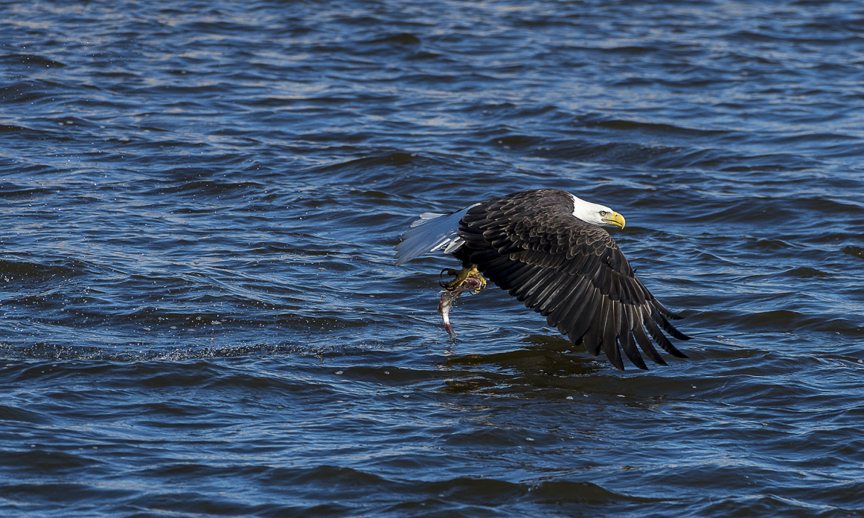
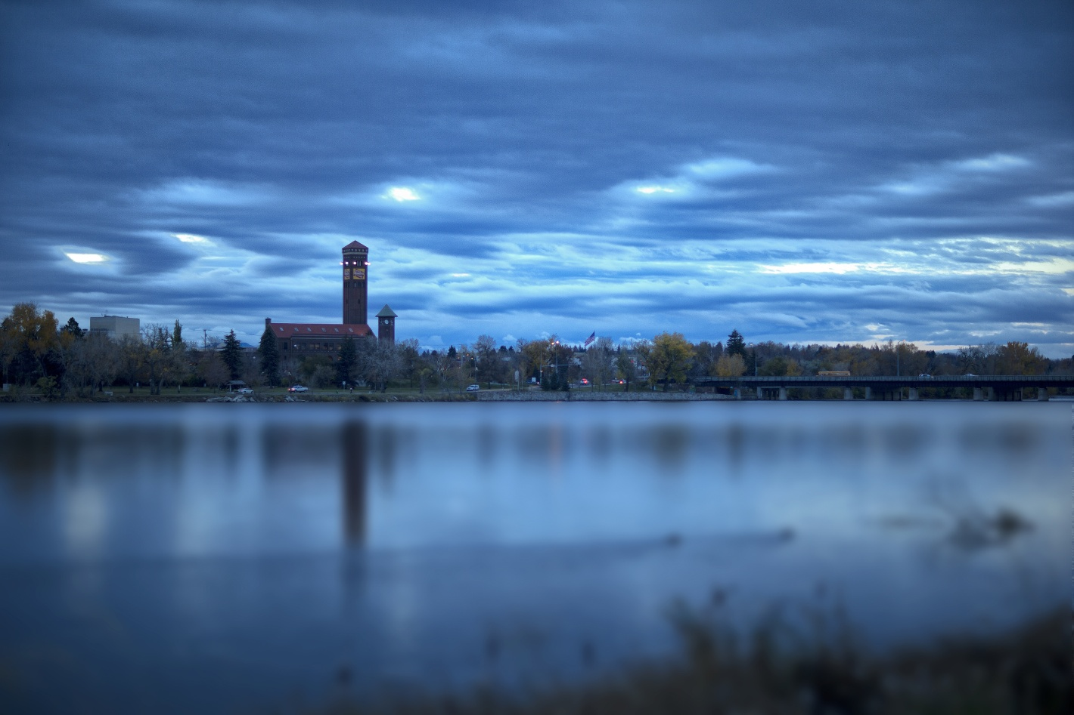
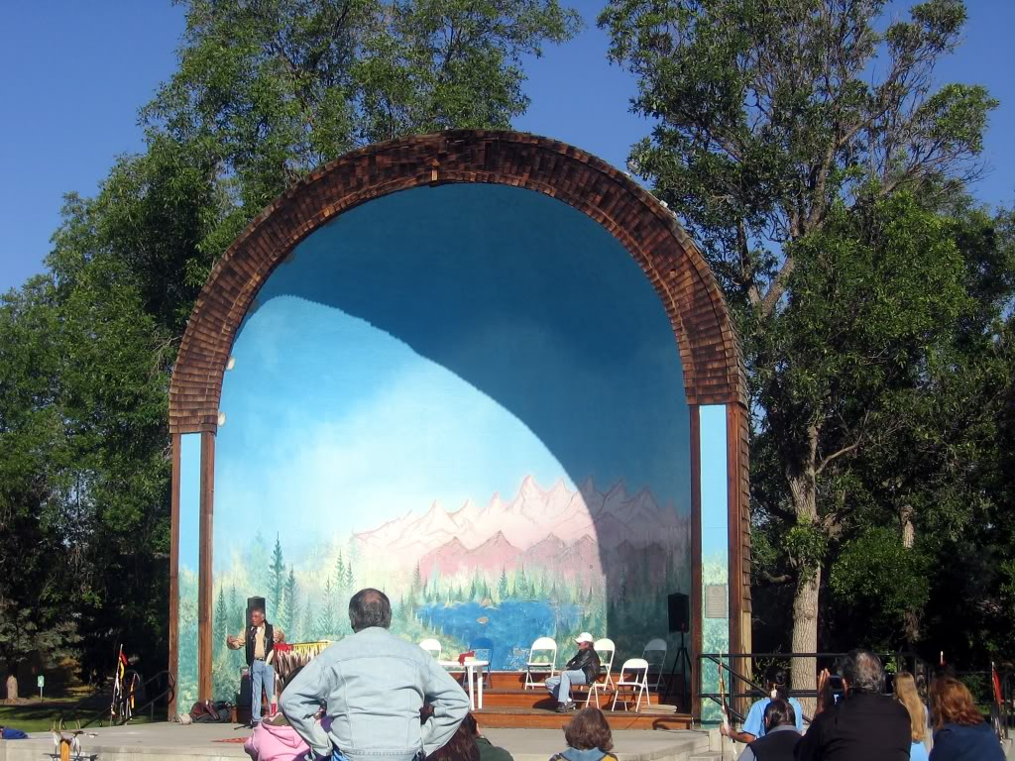
MONTANA
APCO
Leaders in Public Safety Communications
VENDOR EXHIBITS!
2016 CONFERENCE
Great Falls, Montana
October 17-19, 2016
Best Western Heritage Inn
http://www.mtapco.org
TRAINING!!
FUN!
Socialize with others in your field!!!
PRIZES!!

Slide 2
MONTANA
APCO
Leaders in Public Safety Communications
2016 CONFERENCE
SCHEDULE
Sunday – 16 October
17:00 - 20:00 Registration Set Up and "Early Bird" Registration
Monday - 17 October
09:00 - 17:00 Check in & Registration – Lobby
09:00 - 17:00 Educational Track Day 1 -Room 1
Dr. Richard B. Gasaway
Do You See What I Hear: Creating shared situational awareness between communications professionals and first responders (1/2 day)
Leader’s Toolbox: Developing leadership based on best practices (1/2 day)
All Day Vendor Set up
Tuesday - 18 October
07:30 - 09:00 Check in & Registration
08:30 - 10:00 Welcome and Key Note Speaker Tim Fox
10:00 - 12:00 Break Out Training
12:00 - 13:30 Lunch in Banquet Hall
13:30 - 15:30 Break Out Training
15:30 - 17:30 Vendor Time
18:00 - 19:30 Dinner in the Banquet Hall – on your own
19:30 - ???? Fun Night to be Announced
Wednesday - 19 October
07:30 - 09:00 Check in & Registration
08:00 - 10:00 Break Out Training
10:00 - 12:00 Break Out Training
12:00 – 15:30 Lunch in Banquet Hall
MT APCO Chapter Meeting / Legislative Update & Break Out Training
Awards Ceremony
Door Prizes & Closing Ceremony
PRICING
MOTEL
Per Day Entire Conference
Member Rate $125 $225
Non-Member $150 $275
The Best Western Heritage Inn has a block of rooms for the conference. Conference Rate is $89 per night. When making reservations ask for the Montana APCO rate.
For more information and to register, go to:
http://www.mtapco.org/2016-conference/

